Slide 1


Embryonic Period (3-8 weeks)
Dr. Khizer Hussain Afroze. M
Associate Professor,
Dept of Anatomy & Neurobiology
COMHS, NUST, Oman

Slide 2
SLOs
1. | Define embryonic period.
2. | Describe major events occurring in embryonic period.
3 | Organ formation.
4 | Embryonic Folding.
5 | Formation of pharyngeal arches.
6 | External appearance is human like.
7 | Formation of upper and lower limbs.
8 | Intestinal herniation.
9 | How to determine age of embryo in embryonic period.

Slide 3
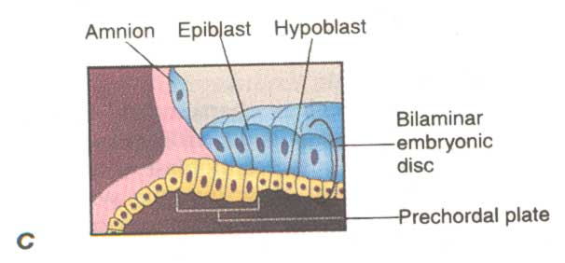
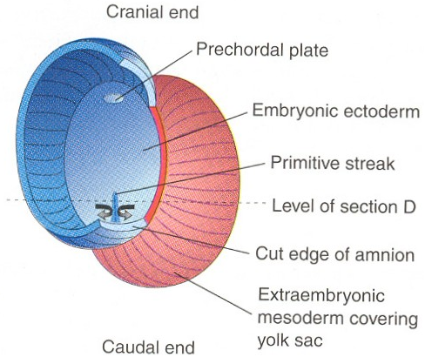
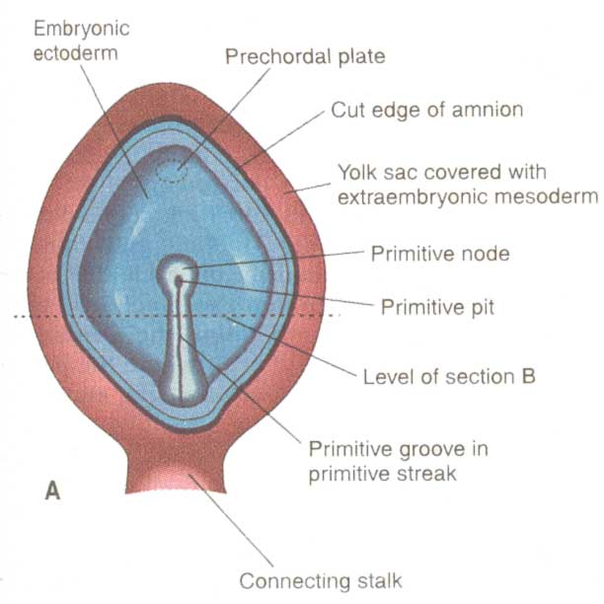
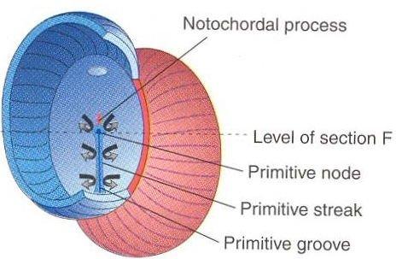
RECAP of Third Week of development
Prechordal Plate
Primitive streak

Slide 4
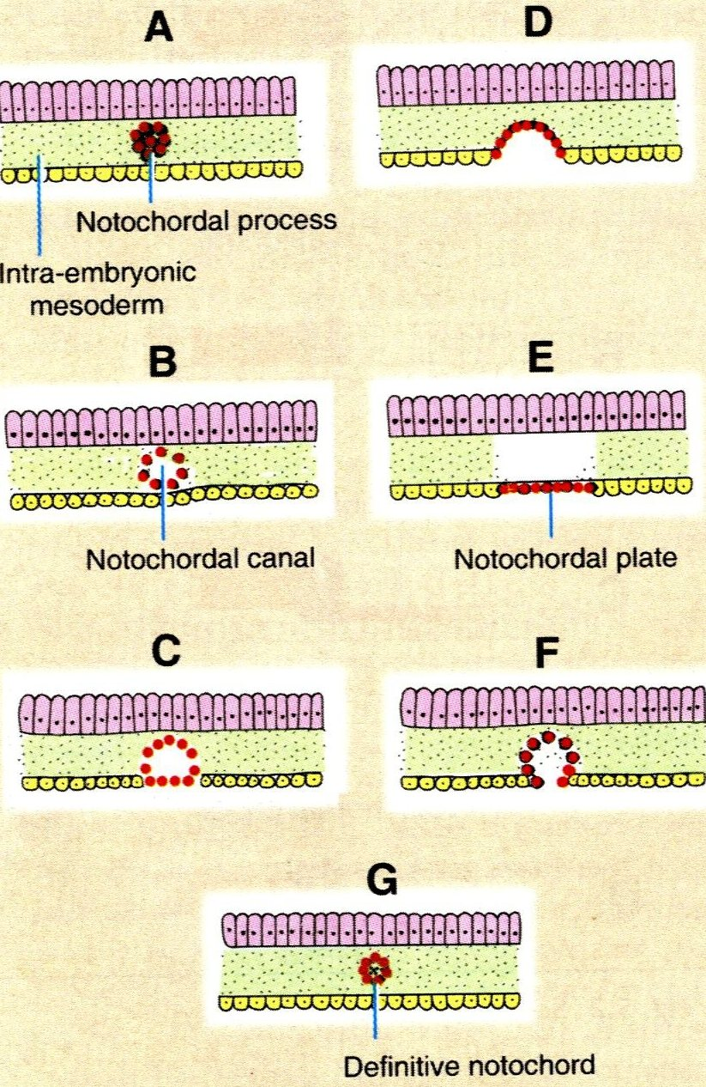
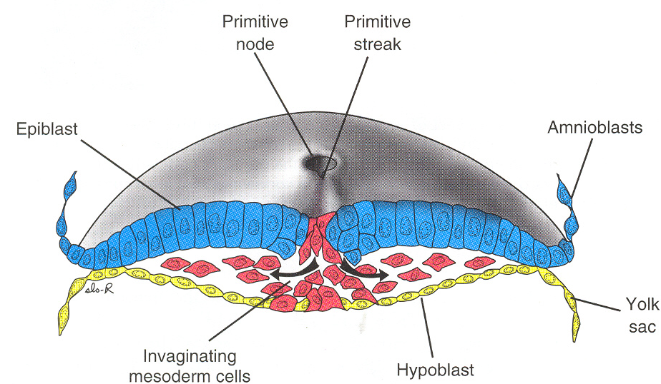
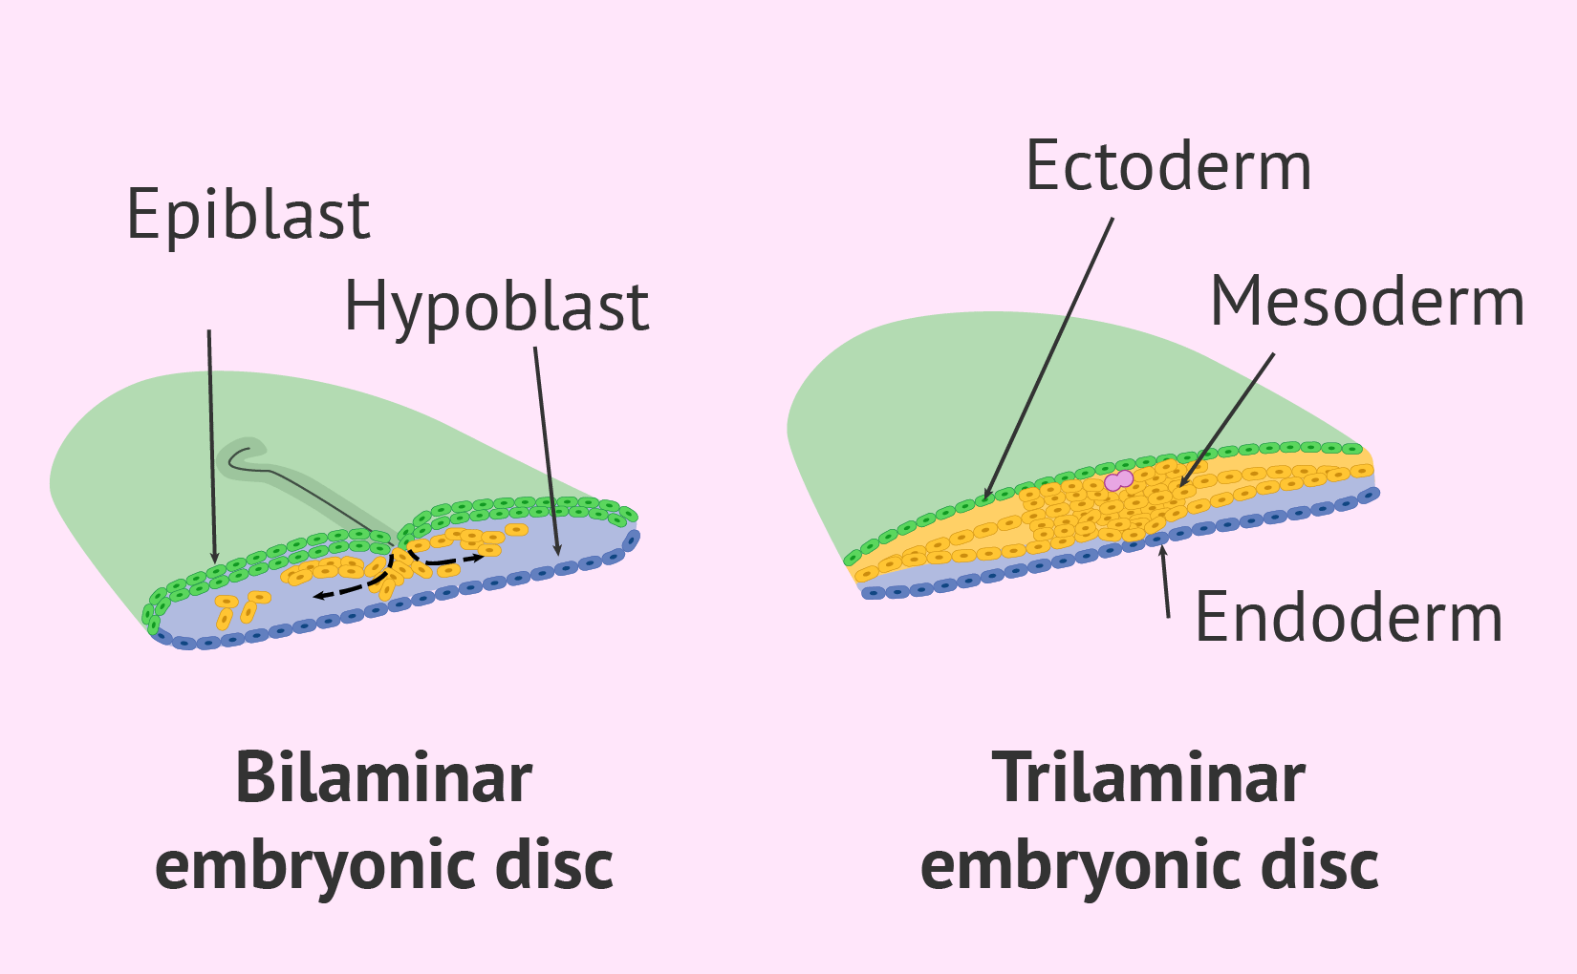
Trilaminar germ disc
& gastrulation
RECAP of Third Week of development
NOTochord Formation

Slide 5
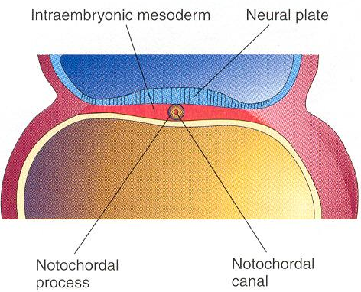
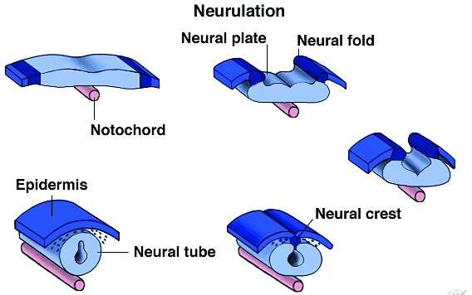
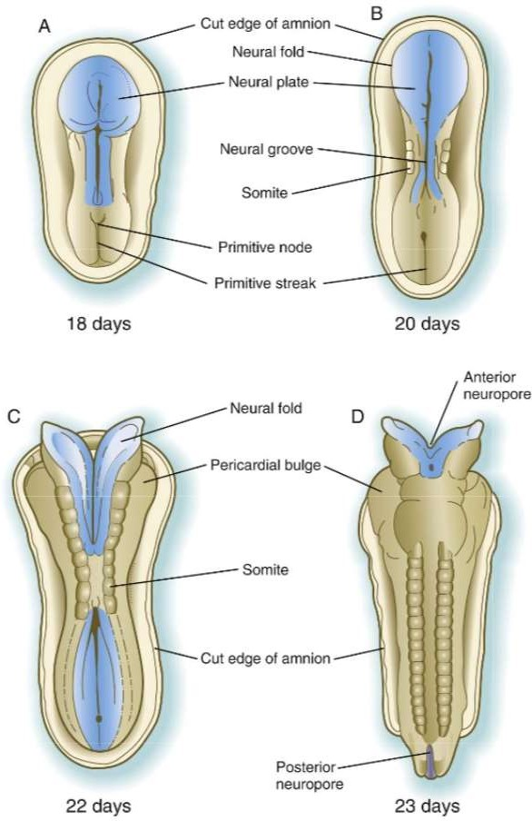
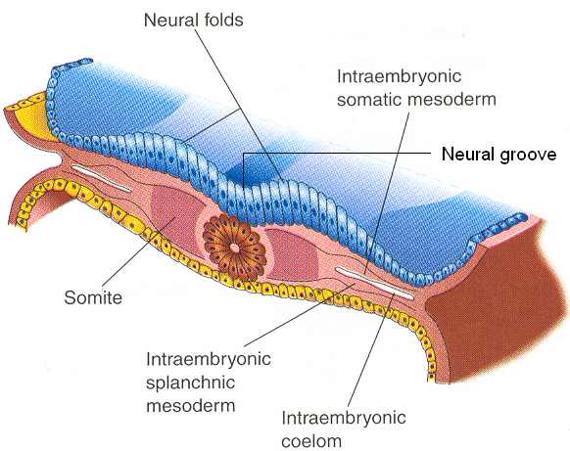
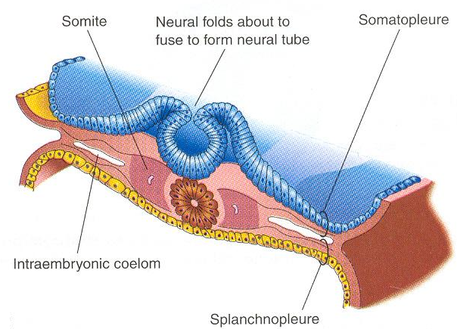
Neural plate
Neural folds
Neural tube
Neural crest cells
Neural tube development

Slide 6
Embryonic period
Extend from week 3-8.
2 major events: organogenesis and morphogenesis.
Organogenesis: stem cells are forming organ primordia.
Morphogenesis: more like human.

Slide 7
Organogenesis
The 3 germ layers: ectoderm, mesoderm, endoderm give derivatives.
Neurulation and formation of CNS.
Formation of GIT and its glands.
Formation of heart and CVS.
Formation of respiratory system.
Formation of genitourinary system.

Slide 8
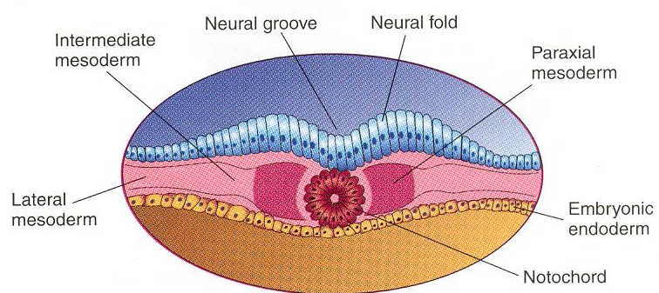
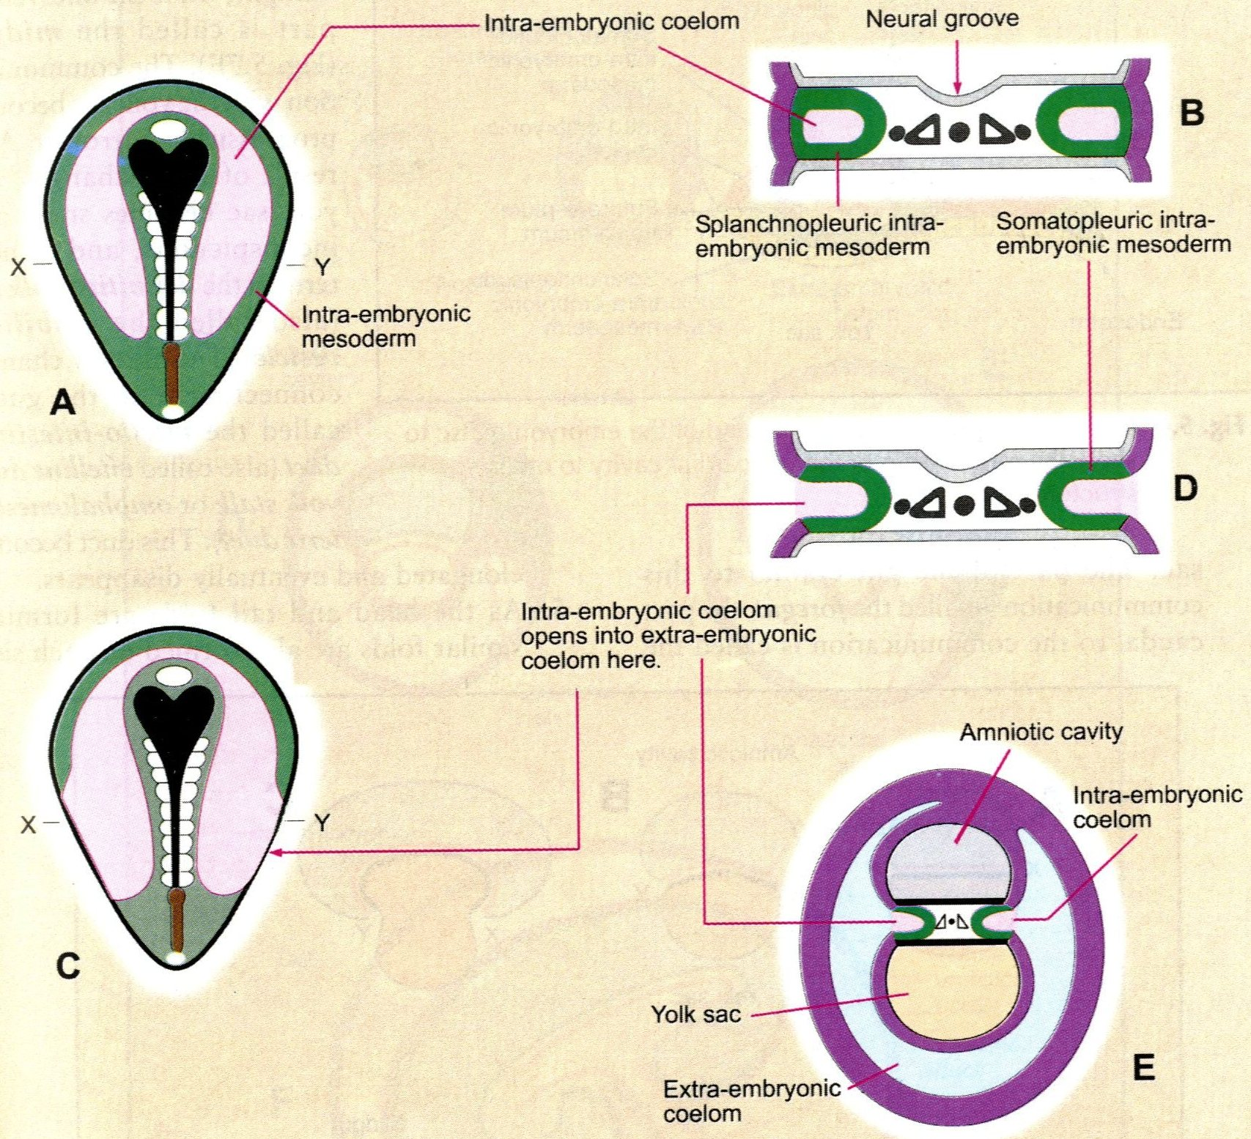
Derivatives of intraembryonic mesoderm
Differentiated into three parts.
The cells close to the midline proliferate & form a thickened plate of tissue – PARAXIAL MESODERM.
More laterally the mesoderm remains thin – LATERAL PLATE MESODERM.
Between these two there is a longitudinal strip of mesoderm – INTERMEDIATE MESODERM.

Slide 9
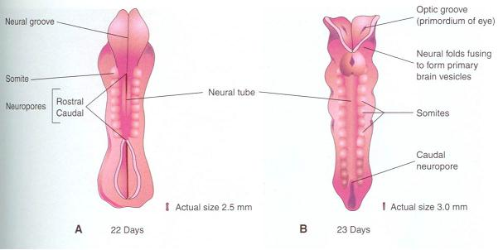
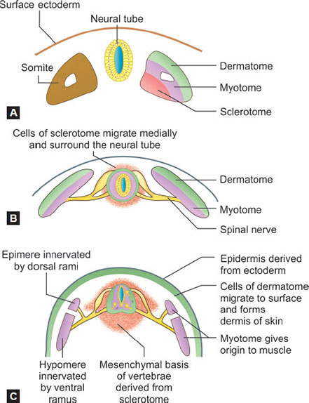
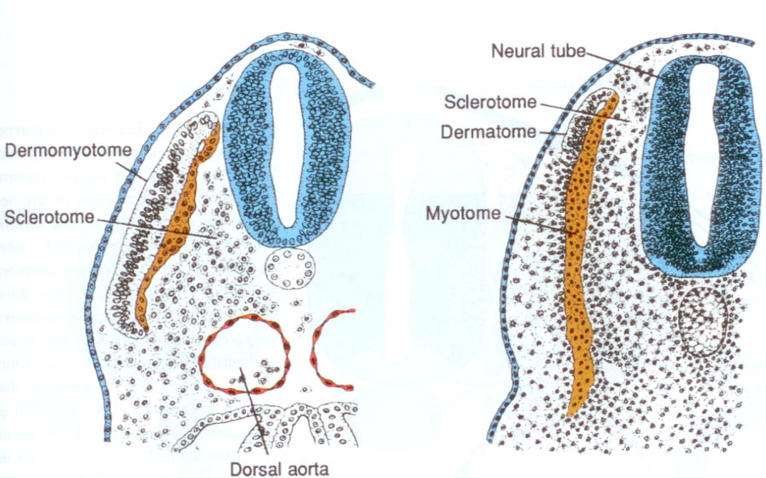
Paraxial mesoderm
Paraxial mesoderm: becomes segmented into somites in a cranio-caudal sequence:
(4 pairs occipital, 8 cervical, 12 thoracic, 5 lumbar, 5 sacral and 8-10 coccygeal). Each somite gives:
  Sclerotome: gives vertebra + ribs + sternum
  Dermo-myotome: Skeletal muscles + Dermis of skin

Slide 10
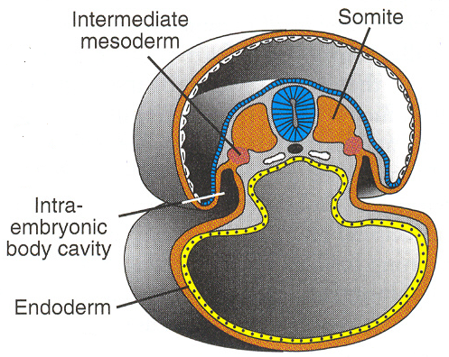
Intermediate and lateral plate mesoderm
Intermediate mesoderm: Urogenital Structures
  kidneys
  Gonads (testis or ovary)
  Genital ducts of both sexes
Lateral plate mesoderm: divided by intraembryonic celom
into somatic and splanchnic layers that give:
  Somatic: Thoracic and abdominal walls
  Splanchnic: Heart + smooth muscles of GIT, respiratory systems
  Intraembryonic celom: Pericardial, pleural and peritoneal cavities
Note:
Intra embryonic coelom forms the
Pleural cavity
Pericardial cavity
Peritoneal cavity

Slide 11
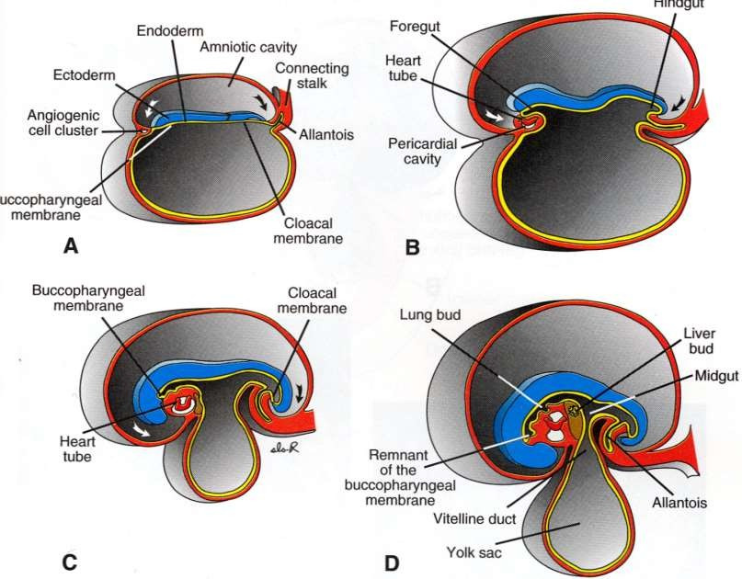
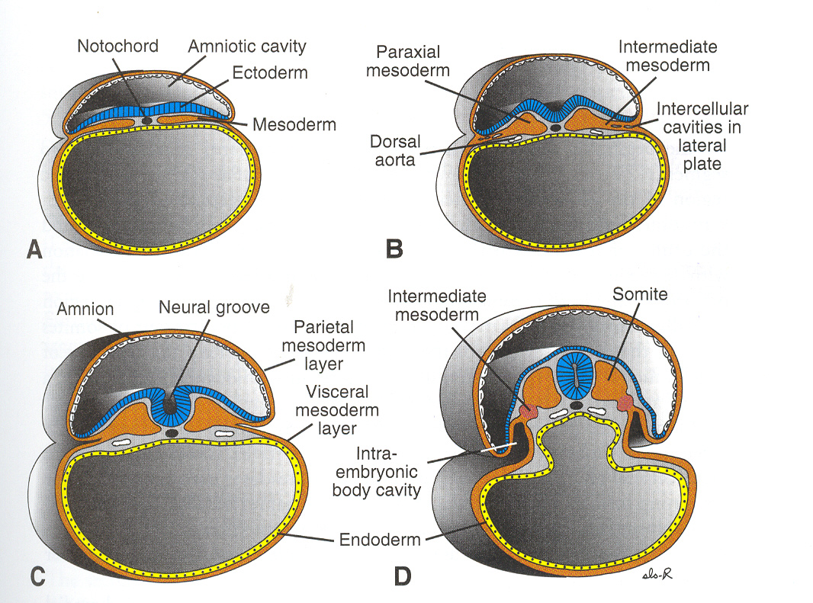
2 lateral folds.
Head and tail folds.
Folding of embryo
Head and tail folds
Lateral folds

Slide 12
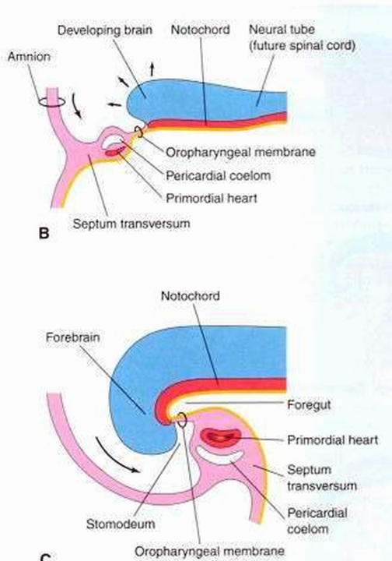
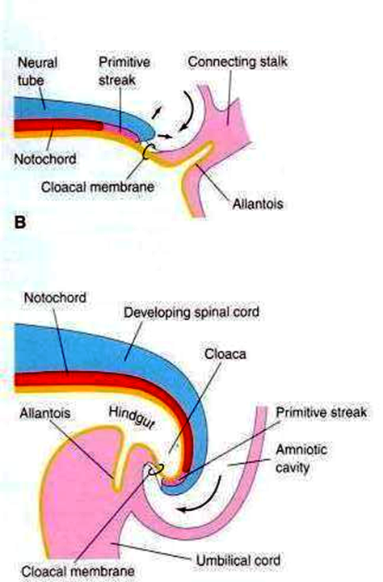
Results of folding
HEAD FOLD
the septum transversum, primordium of the heart & oropharyngeal
membrane move to the
Ventral surface of the embryo in that order in caudal to Cranial sequence forming head fold.
The primitive streak originally cranial to the cloacal membrane comes to lie caudal to it on the ventral surface.
Connecting stalk attachment also is shifted to the ventral surface.
Allantois is partially incorporated into the embryo

Slide 13
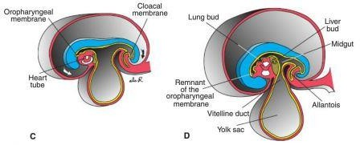
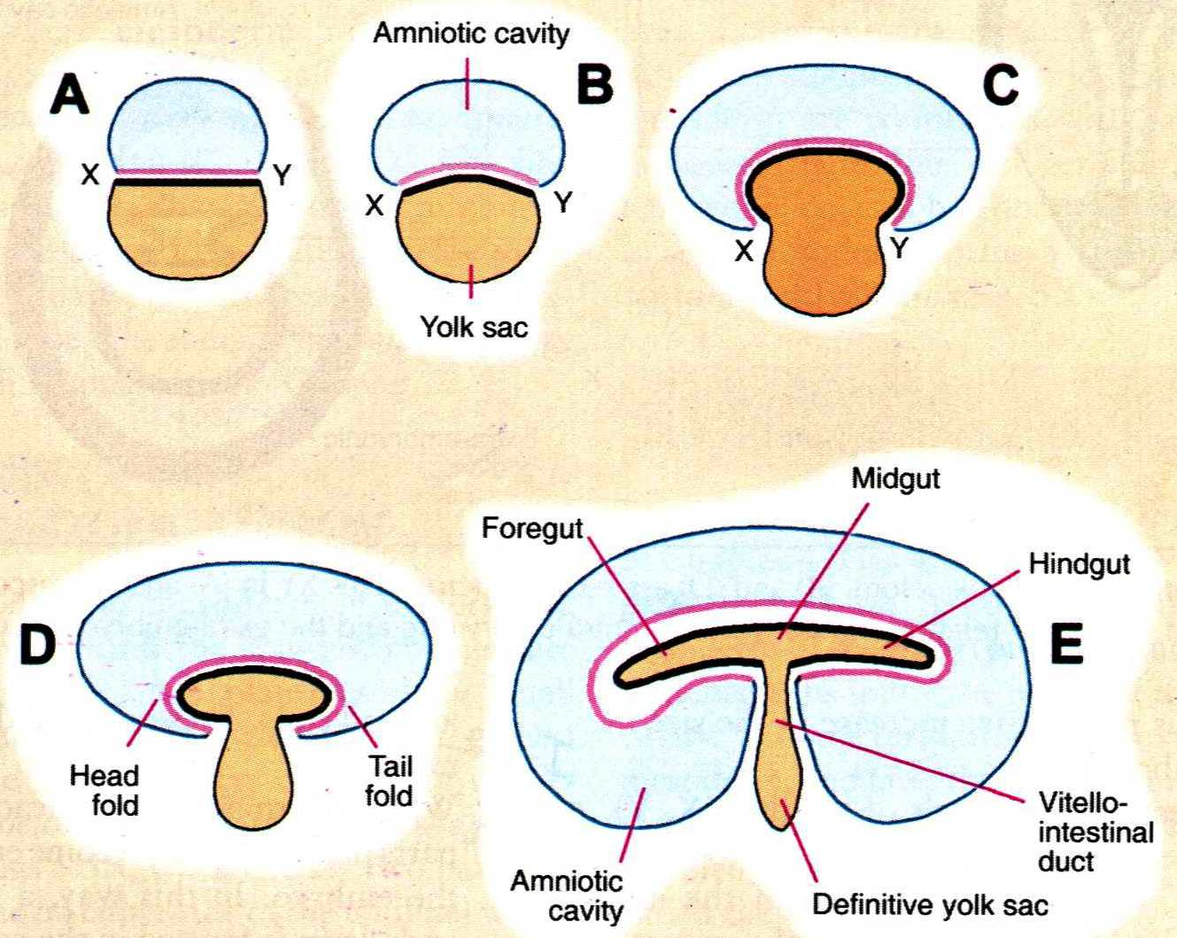
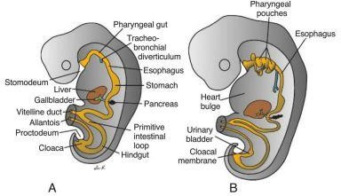
Gut tube
Divides into foregut, midgut and hindgut.
Midgut connects with yolk sac by the vitelline duct.

Slide 14
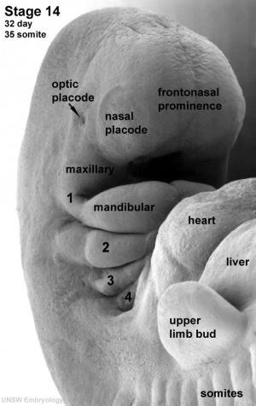
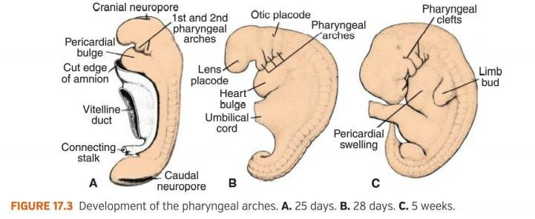
Formation of pharyngeal arches
Appear in the fourth and fifth weeks of development.
Contribute to the characteristic external appearance of the embryo.

Slide 15
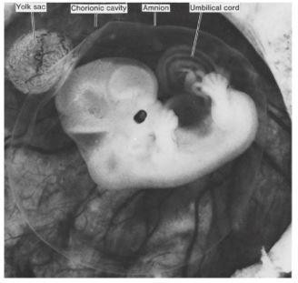
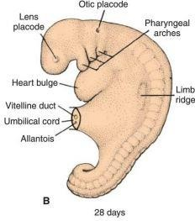
External appearance in the second month More human like
Increase in head size.
Formation of face
Formation of eyes.
Formation of ears.
Formation of nose.
Formation of limbs.
7 weeks

Slide 16
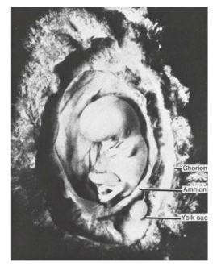
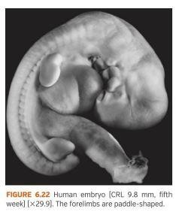
Formation of upper and lower limbs
Appearance of limb bud at the 5th week.
The upper and lower limbs grow in length and divide into 3 parts.
Digital rays appear in the hand and foot and fingers and toes are well formed in the 8th week.

Slide 17
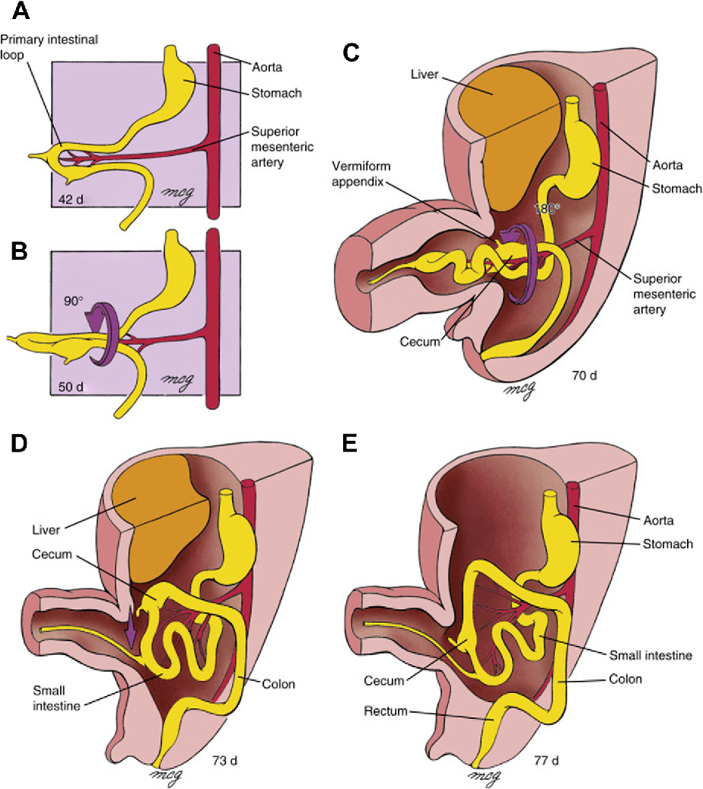
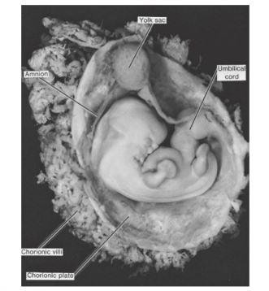
Herniation of intestinal loops
Start in the 6th week.
Into the umbilical cord.
Return back in the 12th week.
6 week

Slide 18
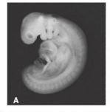
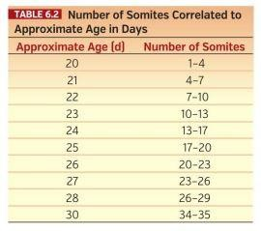
How to determine age
1. Number of somites
28 somite embryo

Slide 19
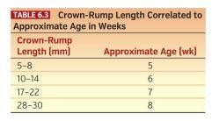
How to determine age
Crown-rump length
  From vertex of skull to midpoint between the apex of buttocks.

Slide 20
references
Langman's Medical Embryology: Third to Eight weeks: The Embryonic Period (page no:73-97)

Slide 21



